Slide 1
Lecture 5 – Operator Overloading
Programming
Principles and Practice Using C++
Shengfa Wang
sfwang@dlut.edu.cn

Slide 2
Overloading the assignment operator
The assignment operator is used to copy the values from one object to another already existing object.
The key words here are “already existing”.

Slide 3
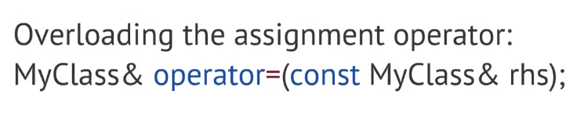

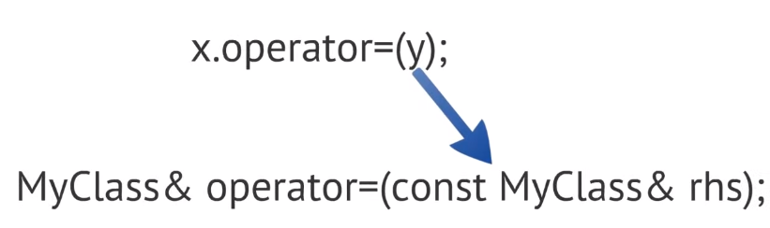
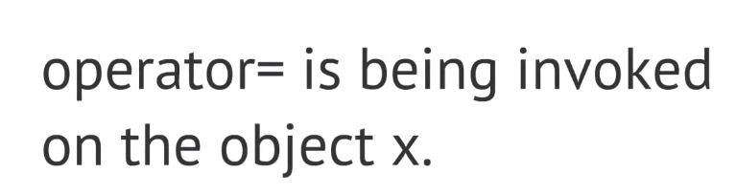
Overloading the assignment operator

Slide 4

The copy constructor and overloading the assignment operator
The assignment operator is used to copy the values from one object to another already existing object. The key words here are “already existing”.
The difference between the copy constructor and the assignment operator causes a lot of confusion for new programmers
  If a new object has to be created before the copying can occur, the copy constructor is used.
  If a new object does not have to be created before the copying can occur, the assignment operator is used.

Slide 5
Shallow vs. Deep Copying
A shallow copy means that C++ copies each member of the class individually using the assignment operator.
  When classes are simple (eg. do not contain any dynamically allocated memory), this works very well.
  When designing classes that handle dynamically allocated memory, memberwise (shallow) copying can get us in a lot of trouble!
  This is because the standard pointer assignment operator just copies the address of the pointer -- it does not allocate any memory or copy the contents being pointed to!

Slide 6
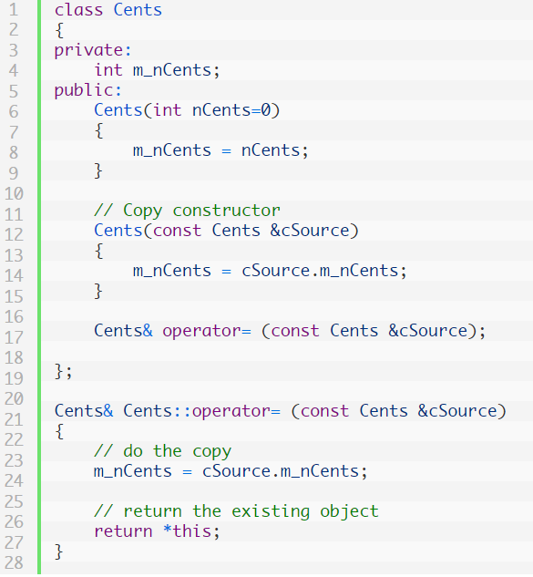

Slide 7
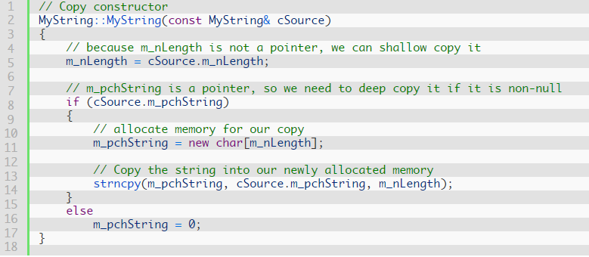
Deep Copy-Copy Constructor
+ 1];
strcpy_s

Slide 8
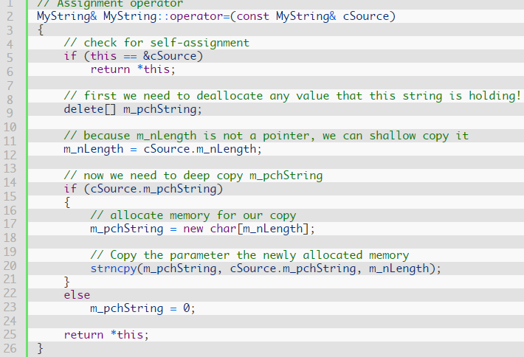
Deep Copy-Overloading Assignment Operator
+ 1];
strcpy_s

Slide 9
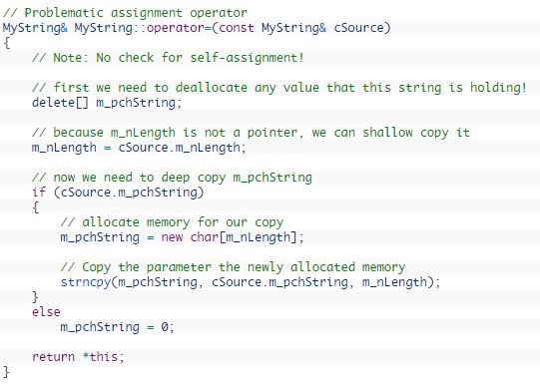
Overloading the assignment operator
+ 1];
strcpy_s

Slide 10
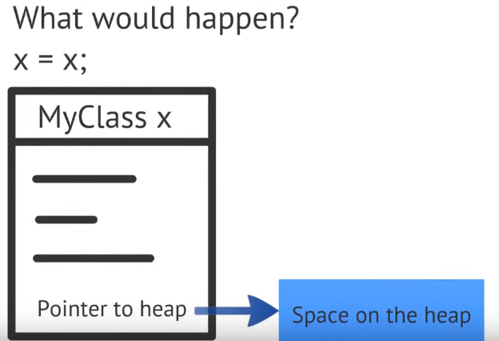
Overloading the assignment operator

Slide 11
Overloading the assignment operator
The default copy constructor and default assignment operators do shallow copies, which is fine for classes that contain no dynamically allocated variables.
Classes with dynamically allocated variables need to have a copy constructor and assignment operator that do a deep copy.
The assignment operator is usually implemented using the same code as the copy constructor, but it checks for self-assignment, returns *this, and deallocates any previously allocated memory before deep copying.

Slide 12
Operator Overloading
Overloading the assignment operator
Shallow vs. deep copying
Introduction to operation overloading
Overloading the arithmetic operators
Overloading comparison operators
Overloading unary operators +, -, and !
Overloading operators using member functions
Overloading the I/O operators
Overloading the increment and decrement operators
Overloading the subscript operators

Slide 13
Operator Overloading
Consider the following examples:
        int nX = 2;
        int nY = 3;
        cout << nX + nY << endl;
C++ already knows how the plus operator (+) should be applied to integer operands
        Mystring cString1 = "Hello, ";
        Mystring cString2 = "World!";
        cout << cString1 + cString2 << endl;
Mystring is a user-defined class, C++ does not know what operator + should do.

Slide 14
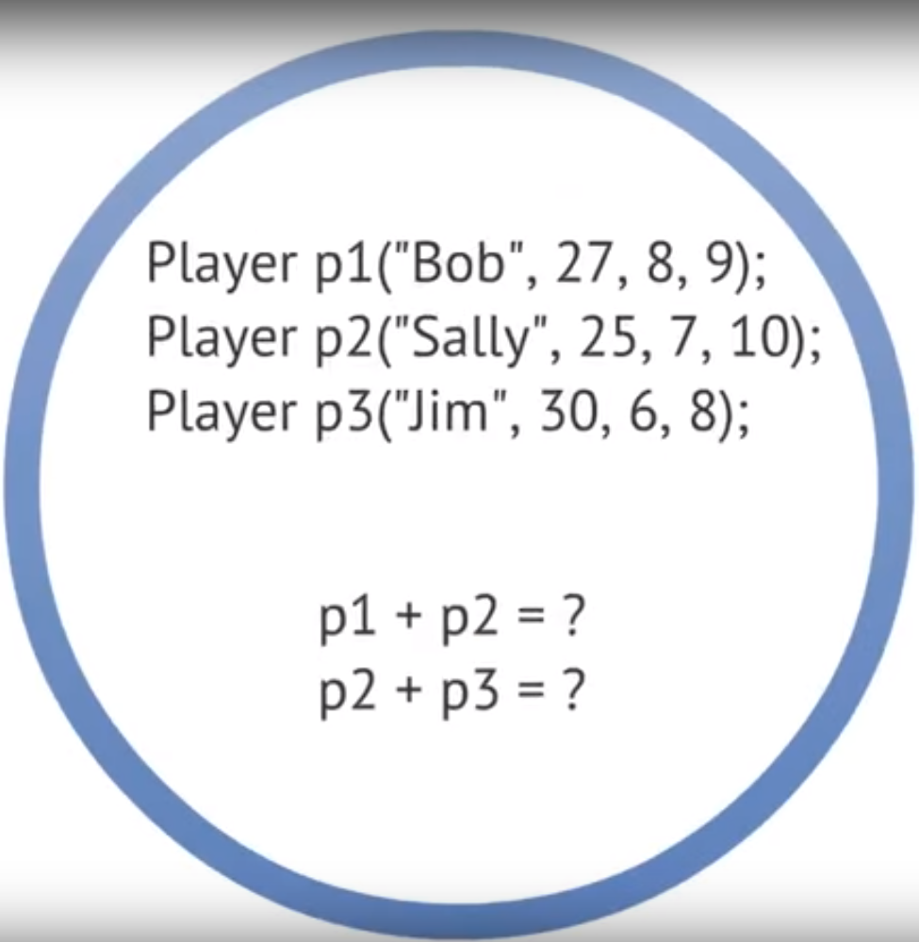
?Summation
?Concatenation

Slide 15
Introduction to operator overloading
Function overloading
  create multiple functions of the same name that work differently depending on parameter types.
Operator overloading
    allows the programmer to define how operators (such as +, -, ==, =, and !) should interact with various data types.
  Operators in C++ are implemented as functions, operator overloading works very analogously to function overloading.

Slide 16
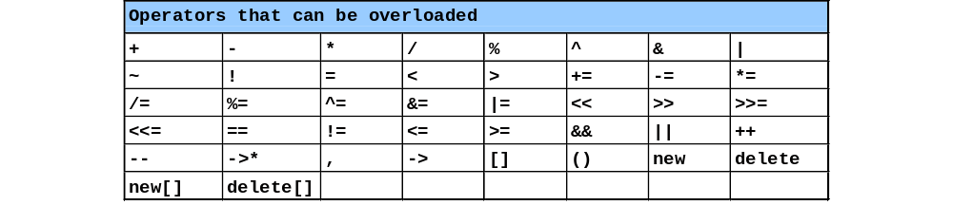
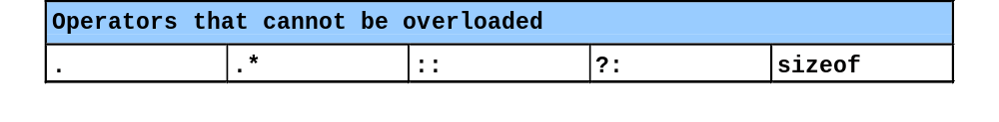
Restrictions on Operator Overloading
C++ operators that can be overloaded
C++ operators that cannot be overloaded
Notes:
Almost any operator in C++ can be overloaded. The exceptions are: those
You can overload the + operator to concatenate your user-defined string class, or add two Fraction class objects together. You can overload the << operator to make it easy to print your class to the screen (or a file). You can overload the equality operator (==) to compare two objects. This makes operator overloading one of the most useful features in C++ -- simply because it allows you to work with your classes in a more intuitive way.
a=(b>0)?b:-b;
？：正则表达式

Slide 17
Restrictions on Operator Overloading
Overloading restrictions
  Precedence of an operator cannot be changed
  Associativity of an operator cannot be changed
  Arity (number of operands) cannot be changed
    Unary operators remain unary, and binary operators remain binary
    Operators &, *, + and - each have unary and binary versions
    Unary and binary versions can be overloaded separately
No new operators can be created
  Use only existing operators
No overloading operators for built-in types
  Cannot change how two integers are added
  Produces a syntax error
Notes:
Before we go into more details, there are a few things to keep in mind going forward.

Slide 18
Operators as functions
nX + nY operator+(nX, nY)
Where operator+ is the name of the function

Slide 19


Operator Overloading
Creating a Member Operator Function
Within Class:
ret-type operator#(argument-list);
Outside Class:
ret-type class-name::operator#(arg-list)
{
// operations
}

Slide 20
Overloading the arithmetic operators
Some of the most commonly used operators in C++ are the arithmetic operators
  That is, the plus operator (+), minus operator (-), multiplication operator (*), and division operator (/). Note that all of the arithmetic operators are binary operators
    meaning they take two operands -- one on each side of the operator.
    All four of these operators are overloaded in the exact same way.
When the operator does not modify its operands, the best way to overload the operator is via friend function.
  None of the arithmetic operators modify their operands
    (they just produce and return a result), so we will utilize the friend function overloaded operator method here.

Slide 21
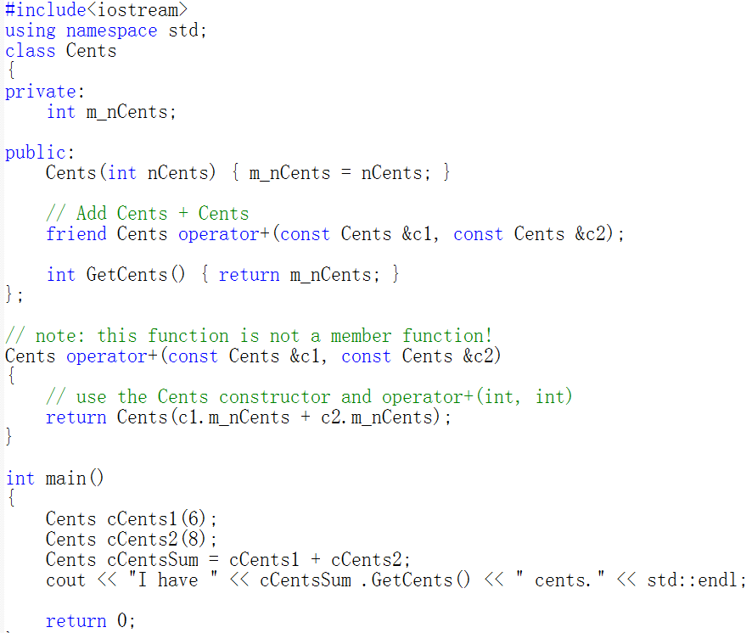
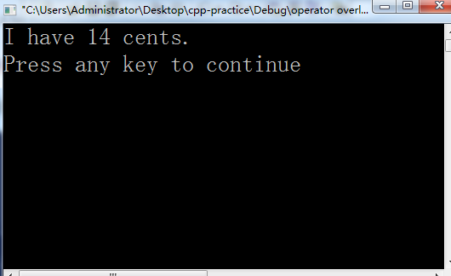
Notes:
how to overload operator plus (+) in order to add two “Cents” objects together

Slide 22
Overloading operators for operands of different types
Often it is the case that you want your overloaded operators to work with operands that are different types.
  For example, if we have Cents(4), we may want to add the integer 6 to this
When C++ evaluates the expression x + y, x becomes the first parameter, and y becomes the second parameter. When x and y have the same type, it does not matter if you add x + y or y + x -- either way, the same version of operator+ gets called.
when the operands have different types, x + y is not the same as y + x.
For example,
  Cents(4) + 6 would call operator+(Cents, int), and 6 + Cents(4) would call operator+(int, Cents). Consequently, whenever we overload binary operators for operands of different types, we actually need to write two functions -- one for each case.

Slide 23
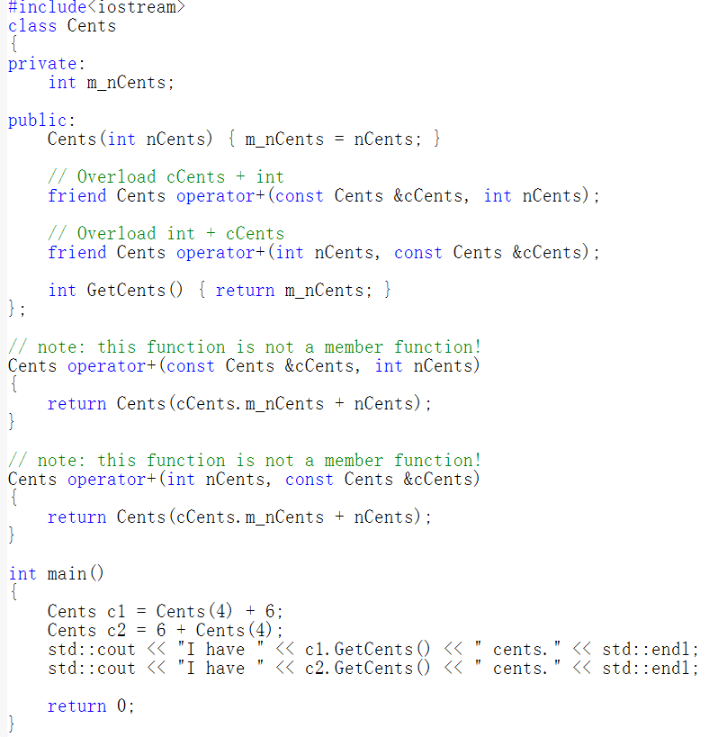

Slide 24
Overloading the comparison operators
Overloading the comparison operators is simple once you’ve learned how to overload the arithmetic operators
The comparison operators are all binary operators that do not modify their operands, we will make our overloaded comparison operators friend functions.

Slide 25
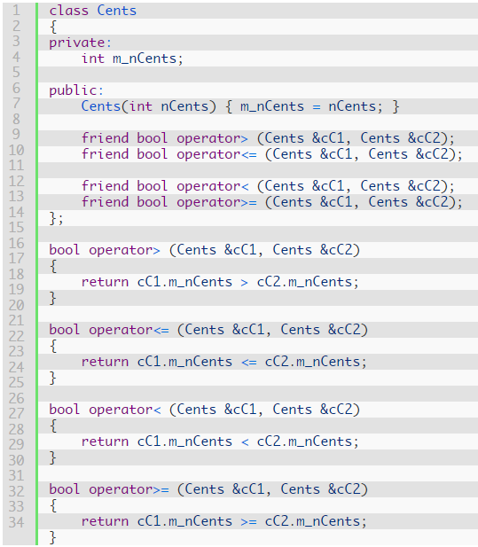
Example with an overloaded operator>, operator<, operator>=, and operator<=:
Note that there is some redundancy here as well. operator> and operator<= are logical opposites, so one could be defined in terms of the other. operator< and operator>= are also logical opposites, and one could be defined in terms of the other.
not to do so because the function definitions are so simple,
Notes:
It doesn’t really make sense to overload operator> or operator< for the Point class. What does it mean for a 3d point to be greater or less than another point? Greater than or less than isn't a concept we normally apply to 3d points, so it's better not to include those operators in the Point class, because the results of the operators (whatever you define them to be) would not be intuitive. Here's a different example with an overloaded operator>, operator<, operator>=, and operator<=:

Slide 26
Overloading unary operators +, -, and !
Unlike the operators you’ve seen so far, the positive (+), negative (-) and logical not (!) operators all are unary operators, which means they only operate on one operand.
  Because none of these operators change their operands, we will be implementing them as friend functions.
All three operands are implemented in an identical manner.
  Class_name operator+(Class_name &Object)
  Class_name operator-(Class_name & Object)
  Class_name operator!(Class_name & Object)

Slide 27
Implement operator- on the Cents class
class Cents
{
private:
int m_nCents;
public:
Cents(int nCents) { m_nCents = nCents; }
// Overload -cCents
friend Cents operator-(const Cents &cCents);
};
// note: this function is not a member function!
Cents operator-(const Cents &cCents)
{
return Cents(-cCents.m_nCents);
}

Slide 28
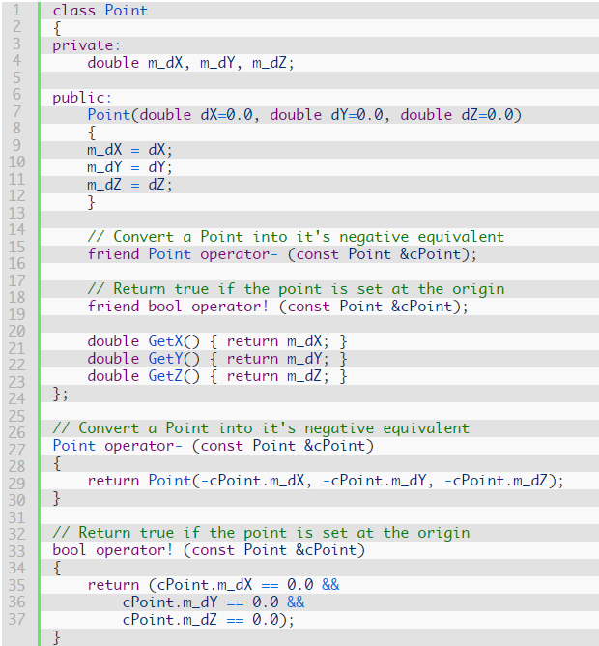
Overload the ! operator
Notes:
In this case, if our point has coordinates (0.0, 0.0, 0.0), the logical not operator will return true. Otherwise, it will return false. Thus, we can say:Point cPoint; // use default contructor to set to (0.0, 0.0, 0.0)
if (!cPoint)
cout << "cPoint was set at the origin." << endl;
else
cout << "cPoint was not set at the origin." << endl;

Slide 29
Overloading operators using member functions
For operators that do modify their operands, we typically overload the operator using a member function of the class. When overloading an operator using a member function:
  The leftmost operand of the overloaded operator must be an object of the class type.
  The leftmost operand becomes the implicit *this parameter. All other operands become function parameters.
Most operators can actually be overloaded either way, however there are a few exception cases:
  If the leftmost operand is not a member of the class type, such as when overloading operator+(int, YourClass), or operator<<(ostream&, YourClass), the operator must be overloaded as a friend.
  The assignment (=), subscript ([]), call (()), and member selection (->) operators must be overloaded as member functions.

Slide 30
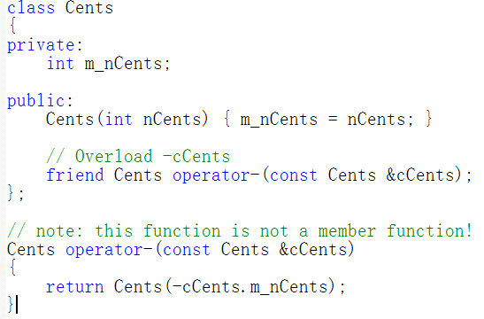
Overloading operators using member functions
The negative operator is a unary operator that can be implemented using either method

Slide 31
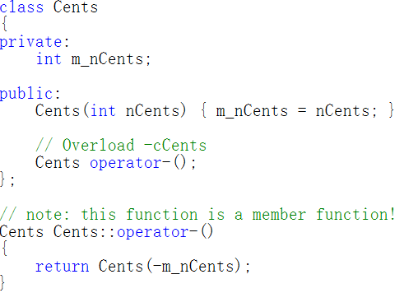
Overloading operators using member functions
Overload the same operator using a member function instead:
Remember that when C++ sees the function prototype Cents Cents::operator-();, the compiler internally converts this to Cents operator-(const Cents *this), which you will note is almost identical to our friend version Cents operator-(const Cents &cCents)!
a member function has an implicit *this pointer which always points to the class object the member function is working on. The parameter we had to list explicitly in the friend function version (which doesn’t have a *this pointer) becomes the implicit *this parameter in the member function version.1

Slide 32
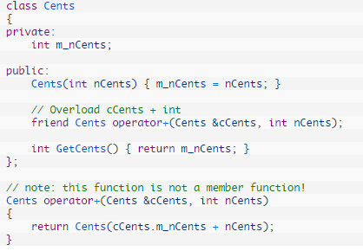
Overloading operators using member functions
An example of a binary operator overloaded both ways

Slide 33
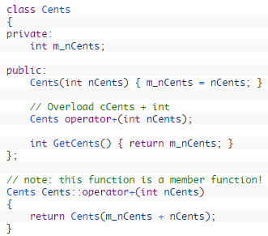
Two-parameter friend function becomes a one-parameter member function, because the leftmost parameter (cCents) becomes the implicit *this parameter in the member function version.

Slide 34

int main(void)
{
cents c1(3);
cents c2 = c1 + 2; // 等价于c1.opertor+ 2; 或 operator+(c1, 2);
return 0;
}

Slide 35
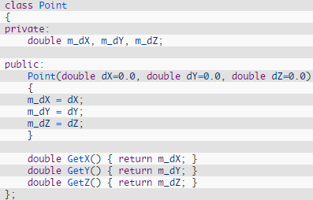


Overloading the I/O operators
int main(){
return 0;
}
int main(){
return 0;
}

Slide 36
Overloading the I/O operators **
cout << cPoint
    The operator is <<.
    The left operand is the cout object, which is an object of type ostream
    The right operand is your Point class object.
Overloaded function:
ostream & operator<<(ostream &out, class-name & object-name)
istream & operator>>(istream &in class-name & object-name)
When the compiler evaluates
cout << cPoint << endl;
( )
Makes no sense!
void << endl;

Slide 37
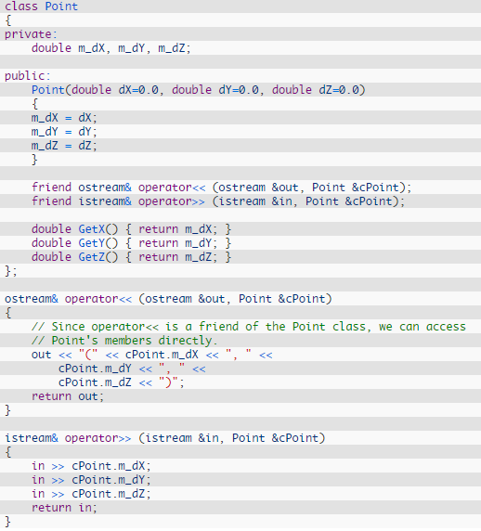
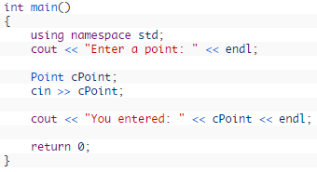

Slide 38
Overloading the I/O operators
ostream& operator<<(ostream &out, class-name & object-name)
Better to be written as:
ostream& operator<<(ostream &out, const class-name & object-name)
However , you have to leave object as non-const because the overloaded operator >> modifies object members
istream& operator>>(istream &in, class-name & object-name)

Slide 39
Overloading the increment and decrement operators
Overloading the increment (++) and decrement (--) operators are pretty straightforward, with one small exception.
There are actually two versions of the increment and decrement operators:
  a prefix increment and decrement (eg. ++nX; --nY;)
  a postfix increment and decrement (eg. nX++; nY--;).
The increment and decrement operators are best overloaded as member functions, because they modify their operands.

Slide 40
Overloading the increment and decrement operators
Distinguishing between pre and post operators
  prefix versions are overloaded the same as other prefix unary operators
  Class_name & operator++();
  convention adopted that when compiler sees postincrementing expression, it will generate the member-function call
  Class_name operator++( int );
int is a dummy value to make the argument list of operator++ distinguishable from the argument list for ++operator
1 2 | int x = 5; int y = ++x; // x is now equal to 6, and 6 is assigned to y
1 2 | int x = 5; int y = x++; // x is now equal to 6, and 5 is assigned to y

Slide 41
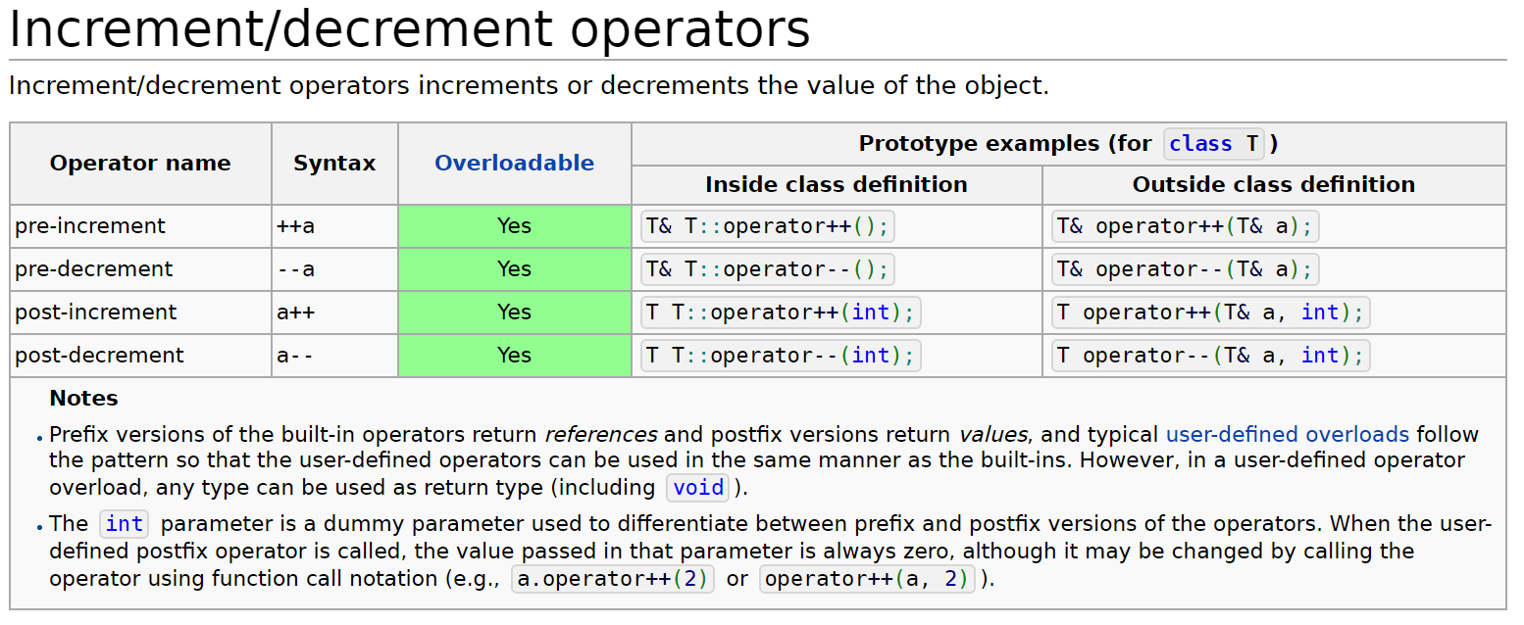
Overloading the increment and decrement operators

Slide 42
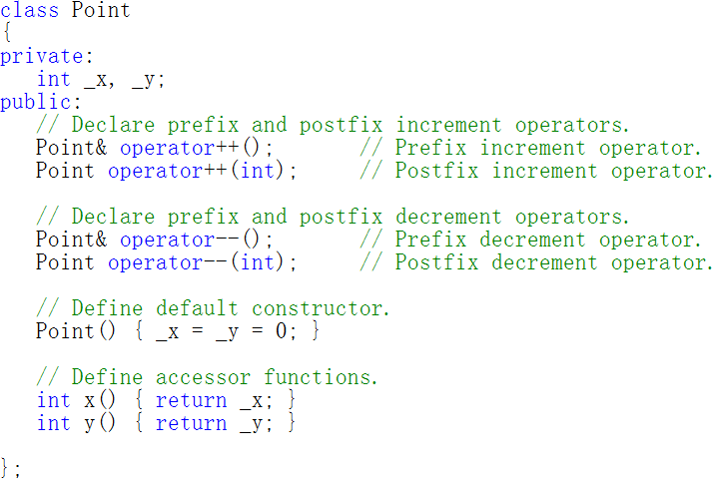
Overloading the increment and decrement operators
Example:

Slide 43
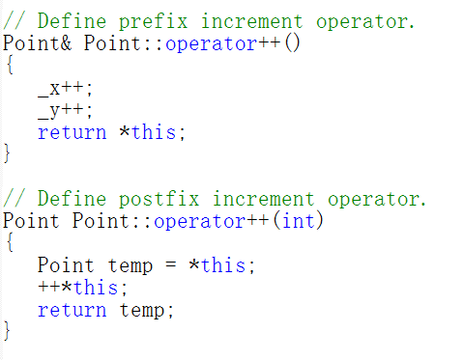

Slide 44
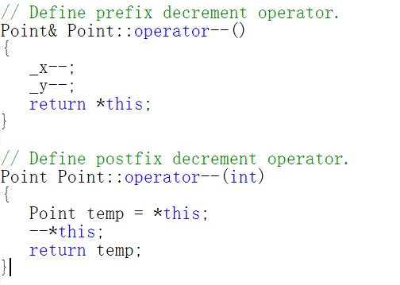

Slide 45
Prefix and postfix overloads
First, distinguish the prefix from the postfix operators by providing an integer dummy parameter on the postfix version
Second, because the dummy parameter is not used in the function implementation, we have not even given it a name. This tells the compiler to treat this variable as a placeholder, which means it won’t warn us that we declared a variable but never used it.
Third, the difference between the prefix and postfix operators is in the value they return.

Slide 46
Overloading the subscript operator
Typically use the subscript operator [] to index specific elements of an array
array[2]=12
Consider the following class
        class IntList
        {
        private:
        int m_anList[10];
        };
        int main()
        {
        IntList cMyList;
        return 0;
        }

Slide 47
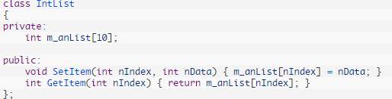
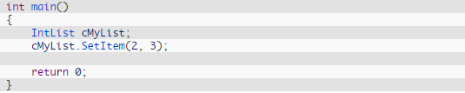

Overloading the subscript operator
Without operator overloading, the typical method would be to create access functions:

Slide 48
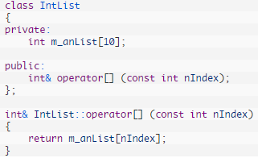
Overloading the subscript operator
A better solution in this case is to overload the subscript operator ([])
Why operator[] returns a reference?
The subscript operator has a higher precedence than the assignment operator,
  cMyList[2] evaluates first.
  return a reference to cMyList.m_anList[2].
Operator[] is returning a reference, it returns the actual cMyList.m_anList[2] array element.
  Our partially evaluated expression becomescMyList.m_anList[2] = 3,
int main()
{
Intlist cMylist;
cMylist[2]=3
cout<<cMylist[2];
return 0;
}

Slide 49
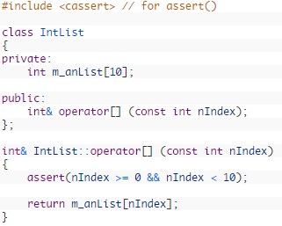
Overloading the subscript operator
The compiler will not complain about the following code:
      int anArray[5];
      anArray[7] = 3; // index 7 is out of bounds!
Make our overloaded subscript operator check to ensure the index is within bounds:

